Slide 1
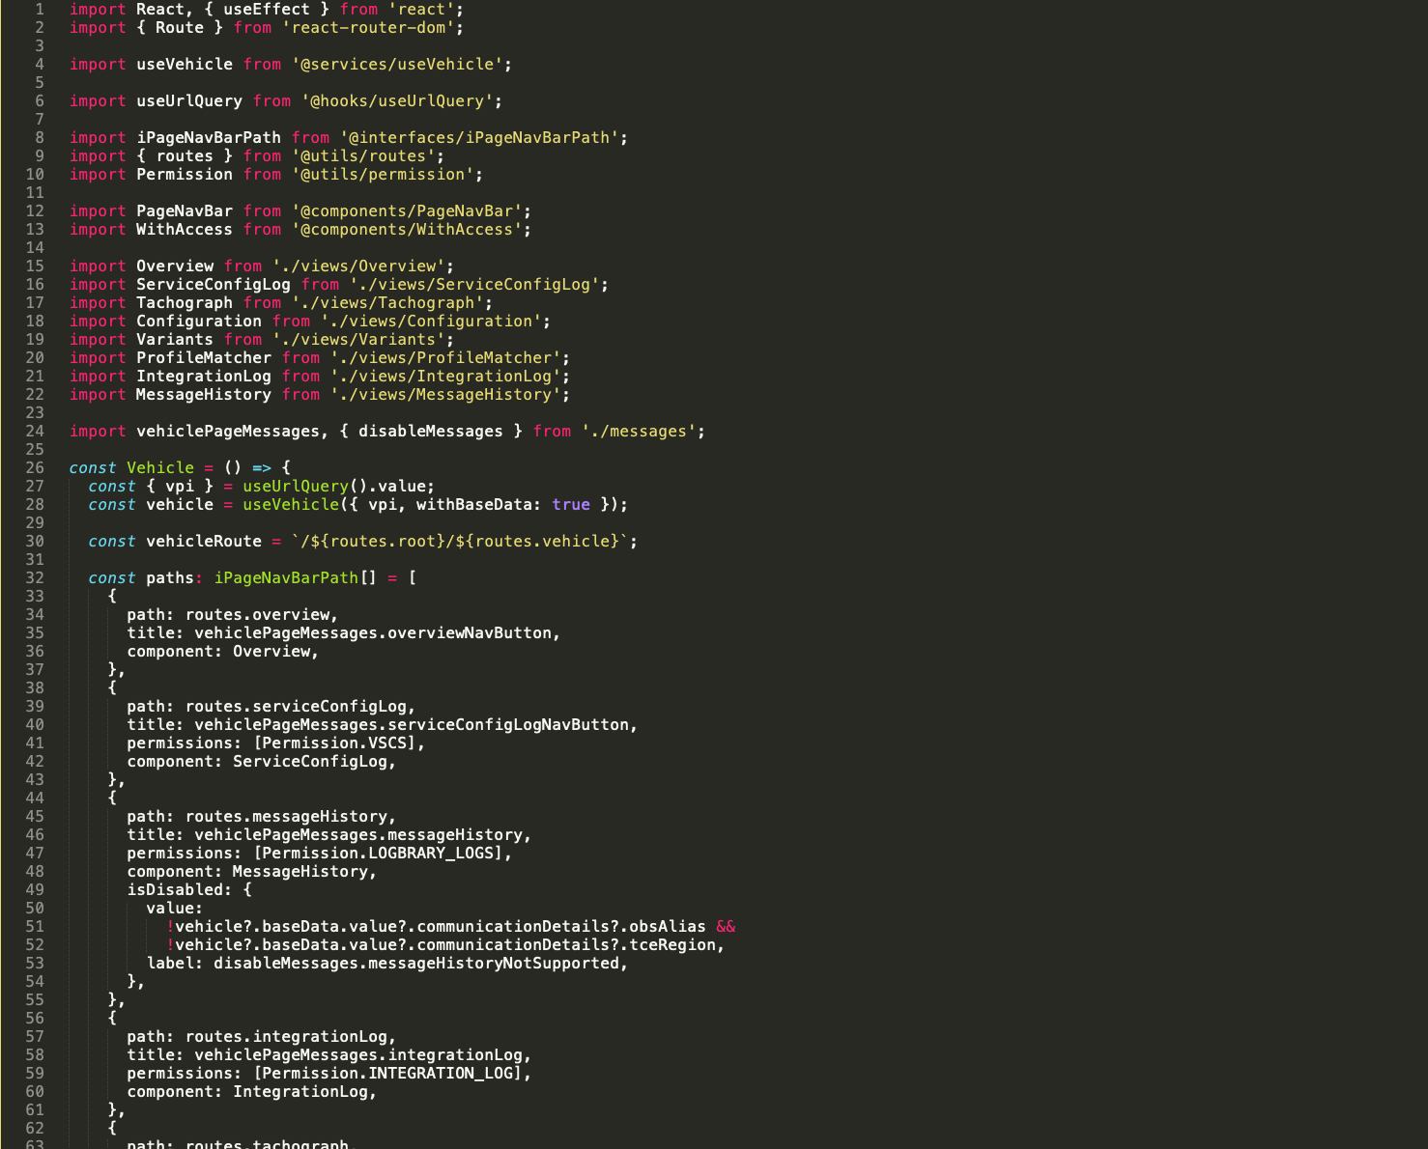
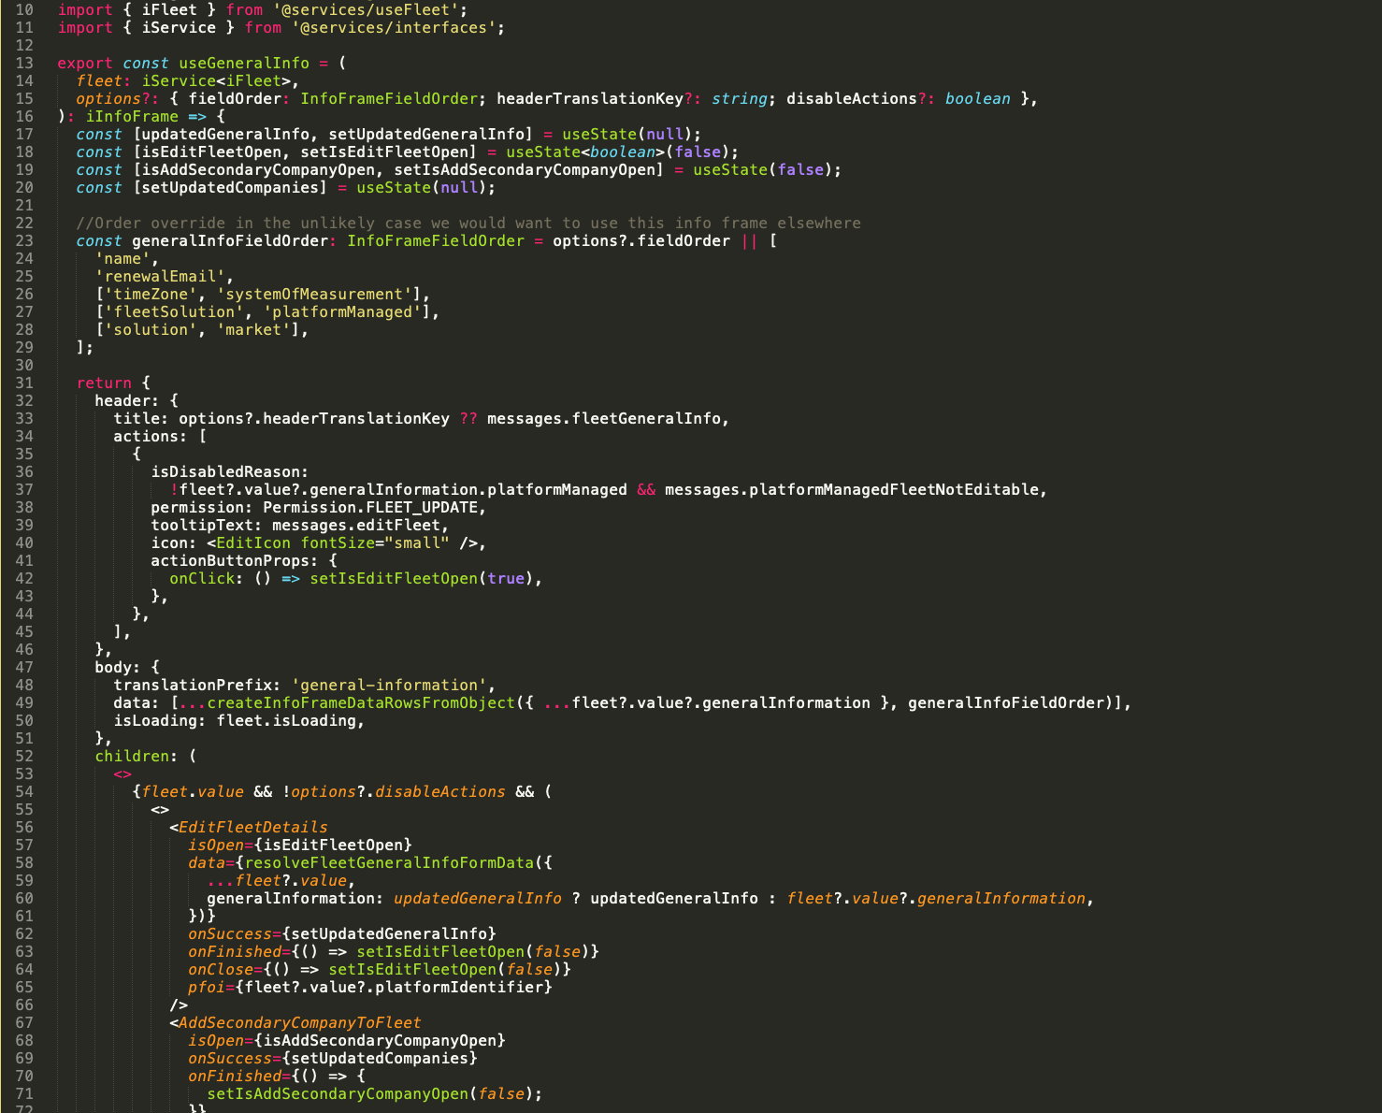
COSTA: Code Assignment
Estimated time: max 4h

Slide 2
Description
In this assignment you are to implement a simplified version of the application we develop.
It is meant to both serve as an evaluation tool for us but also to give you a small taste of what we work with in terms of languages, technologies and types or problems.
A mock API is supplied with the assignment. This mock API uses the tool Mockoon. No changes to the API is permitted. Further instructions on how to configure and use Mockoon can be found on: https://mockoon.com/
The estimated maximum time to complete the assignment is 4 effective hours, but you are free to spend as much time as you like. Time taken will not negatively impact the evaluation.

Slide 3
Submission and Evaluation
Your submission is expected as a repository url (GitHub preferred) emailed as a response to the email containing the assignment. A reviewable commit log on the repository is considered a bonus.
Your submission is expected latest at 23:59 on Friday the 23rd of February.
Your submission must contain a Readme with description of how to setup and run the application.
Your submission will be evaluated based on code quality, architecture and functionality.

Slide 4
Assignments
If no other instructions are given
The web application assignment is intended for front end developers
The Server application is intended for backend developers

Slide 5
Assignment: Web Application
The main objective is to build a web application that consists of 3 pages
The landing page:
shows a list of available vehicles and allows the user to pick one
The information overview page contains:
A table with all available information about the vehicle
A list of all ACTIVE services
The Service Overview page:
Shows a list of all services
Show all details about all services
Allows the user to filter the list of services by service status
Bonus Objectives:
Use typescript
Use React router
Use Material UI React

Slide 6
Assignment: Server Application
The main objective is to build a GraphQL serving application.
The applications primary goal is to collect all data from the mock API and make it searchable.
Database:
The application should collect the data from the mock API and store it in a persisted database
The Query response template should include:
Full vehicle information including name and id
List of all services
Queries:
Find vehicle by id (Level: Basic)
Accepts a string
Returns a vehicle where the vehicle id matches the supplied string (assume uniqueness of id)
Find vehicle by Partial Name (Level: Intermediate)
Accepts a string
Returns vehicles where the vehicle name partially or fully matches the supplied string
Find vehicle by Service Status (Level: Advanced)
Accepts a service name and a service status
Returns all vehicles where the specified service has the specified status
Bonus Objectives:
Use MongoDB

Slide 7
API Description

Slide 8
API Description: Get Vehicle list
Endpoint: /vehicle
Method: GET
Responses:
200: List of available vehicle

Slide 9
API Description: Get Vehicle Info
Endpoint: /vehicle/list
Method: GET
Query Parameters:
id : id of the vehicle you wish to look up
Responses:
200: Information about the vehicle
400: id missing from request
401: attempt to access a vehicle you are unauthorised to access
404: vehicle id not found

Slide 10
API Description: Get Vehicle Services
Endpoint: /vehicle/services
Method: GET
Query Parameters:
id : id of the vehicle you wish to look up
Responses:
200: List of vehicle services
400: id missing from request
401: attempt to access a vehicle you are unauthorised to access
404: vehicle id not found

